Slide 1
Programming for Beginners
Introduction to Java Programming

Slide 2
Why should you learn how to program?
Game development
Mark Zuckerberg, Bill Gates, Gabe Newell, Markus Persson
A valuable skill to hold
There’s a high demand for programmers
You’re offered classes for free
Notes:
Single-Page Applications (SPAs) are Web apps that load a single HTML page and dynamically update that page as the user interacts with the app. SPAs use AJAX and HTML5 to create fluid and responsive Web apps, without constant page reloads. However, this means much of the work happens on the client side, in JavaScript. A SPA can redraw any part of the UI without refreshing the page. It’s a web application that fits on one page. Initial page render – consider a shell, chunking of html. Data is separated from the presentation.

Slide 3
Alright, so you’ve convinced me. What do I need?
A functioning brain
A computer
Hands
Patience
Notes:
Single-Page Applications (SPAs) are Web apps that load a single HTML page and dynamically update that page as the user interacts with the app. SPAs use AJAX and HTML5 to create fluid and responsive Web apps, without constant page reloads. However, this means much of the work happens on the client side, in JavaScript. A SPA can redraw any part of the UI without refreshing the page. It’s a web application that fits on one page. Initial page render – consider a shell, chunking of html. Data is separated from the presentation.

Slide 4
So, tell me a bit about programming
The Google definition “programming: creating a sequence of instructions to enable the computer to do something.”
You can make anything
Many different language to choose from
It’s that not difficult
Notes:
Single-Page Applications (SPAs) are Web apps that load a single HTML page and dynamically update that page as the user interacts with the app. SPAs use AJAX and HTML5 to create fluid and responsive Web apps, without constant page reloads. However, this means much of the work happens on the client side, in JavaScript. A SPA can redraw any part of the UI without refreshing the page. It’s a web application that fits on one page. Initial page render – consider a shell, chunking of html. Data is separated from the presentation.

Slide 5
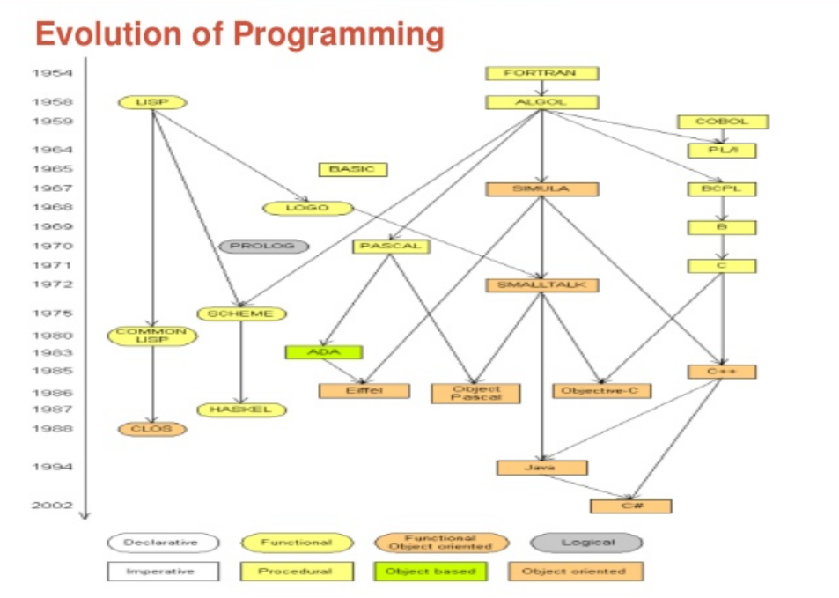

Slide 6
Programming Language
A programming language is a notational system intended primarily to facilitate human-machine interaction.
The notational is understood both by human and machine.
The programming language has Syntax, and language elements have Semantics.

Slide 7
What is a program?
A program is something that is produced using a programming language.
A program is structured entity with Semantics.

Slide 8
What is Object Oriented Programming?
Object-oriented programming (OOP) is a programming language model organized around objects rather than "actions" and data rather than logic. Historically, a program has been viewed as a logical procedure that takes input data, processes it, and produces output data.

Slide 9

Who invented Java?
James Arthur Gosling is a Canadian who is generally credited with having invented the Java programming language in 1994 while working at Sun Microsystems.

Slide 10
Components of Object Oriented Programming
1. Class
2. Object
3. Abstraction
4. Encapsulation
5. Inheritance
6. Polymorphism

Slide 11
What is a Class?
A class is nothing but a blueprint or a template for creating different objects which defines its properties and behaviors. Java class objects exhibit the properties and behaviors defined by its class. A class can contain fields and methods to describe the behavior of an object.

Slide 12
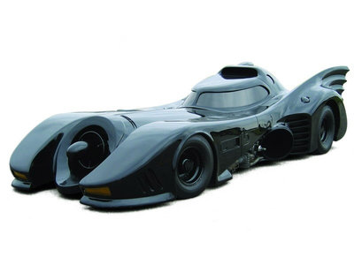
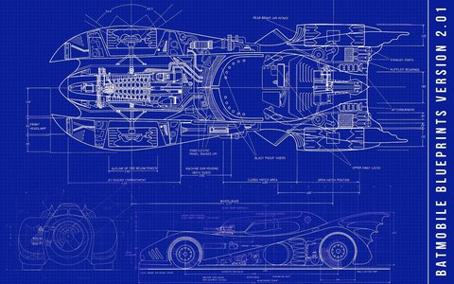
Class & Object
Class
Object
Notes:
Single-Page Applications (SPAs) are Web apps that load a single HTML page and dynamically update that page as the user interacts with the app. SPAs use AJAX and HTML5 to create fluid and responsive Web apps, without constant page reloads. However, this means much of the work happens on the client side, in JavaScript. A SPA can redraw any part of the UI without refreshing the page. It’s a web application that fits on one page. Initial page render – consider a shell, chunking of html. Data is separated from the presentation.

Slide 13
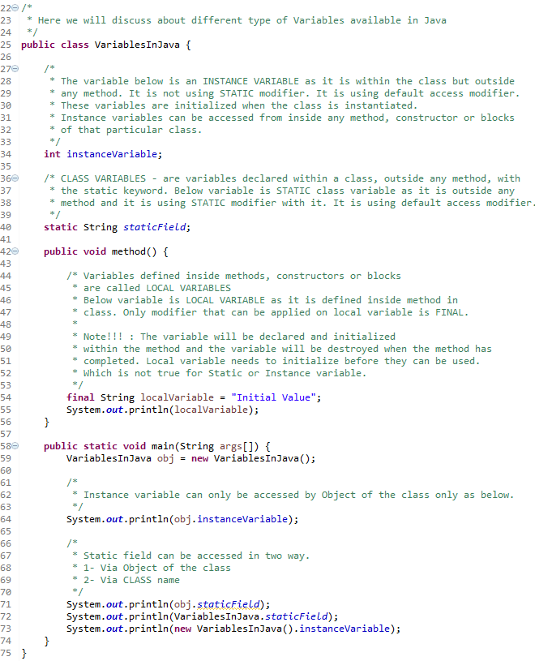
Class
Instance Variable
Class Variable
Local Variable

Slide 14
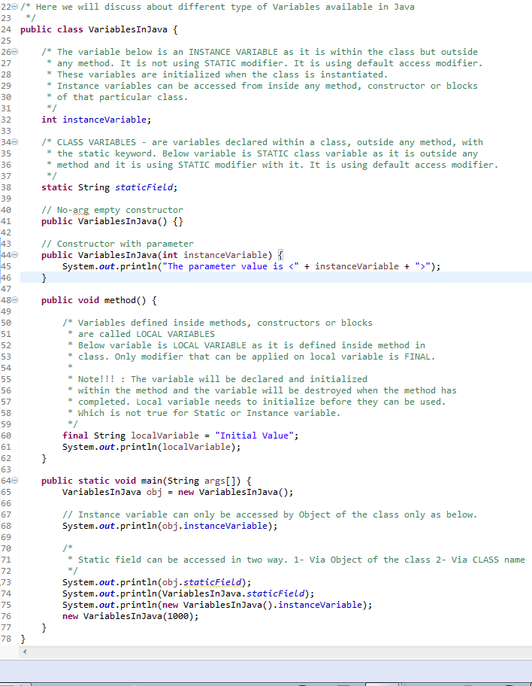
Class
Instance Variable
Class Variable
Local Variable
Constructor

Slide 15
Abstraction
In the computer science perspective, Abstraction is the process of separating ideas from their implementation.
Abstraction in java is used to define only ideas in one class so that the idea can be implemented by its sub classes according to their requirements
Abstraction in java is implemented using Abstract classes and Interfaces.

Slide 16
Abstract Class
Abstract classes and abstract methods are declared using ‘abstract‘ keyword. We can’t create objects to those classes which are declared as abstract. But, we can create objects to sub classes of abstract class, provided they must implement abstract methods

Slide 17
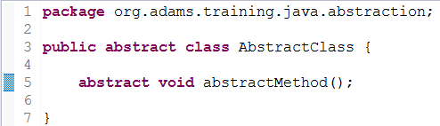
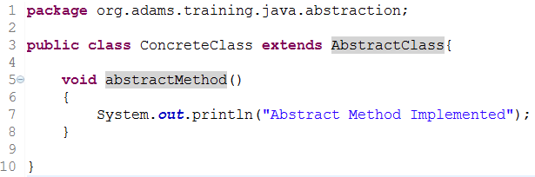
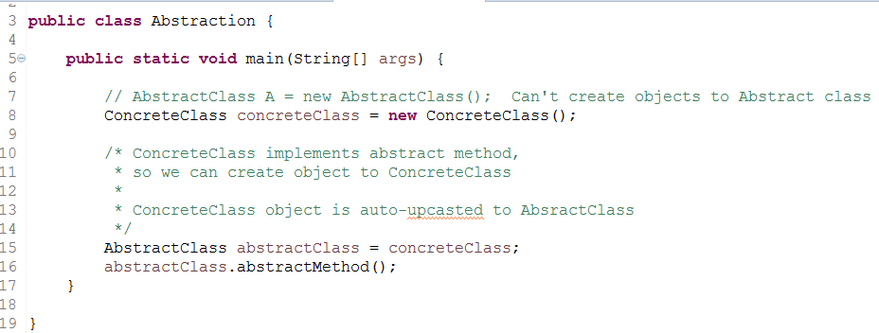
Abstract Class

Slide 18
Abstract Class
The methods which are not implemented or which don’t have definitions must be declared with ‘abstract’ keyword and the class which contains it must be also declared as abstract.

Slide 19
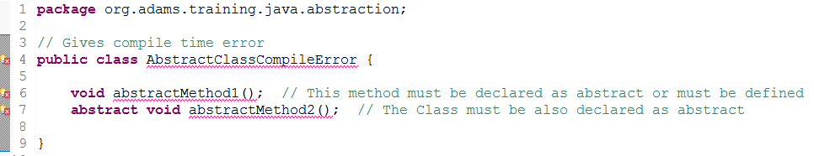
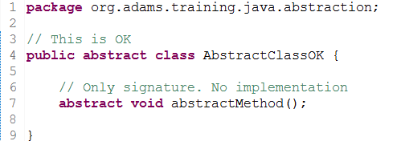
Abstract Class

Slide 20
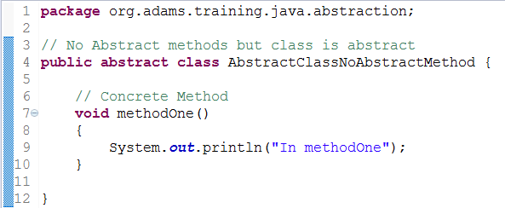
Abstract Class
It is not compulsory that abstract class must have abstract methods. It may or may not have abstract methods. But the class which has at least one abstract method must be declared as abstract.

Slide 21
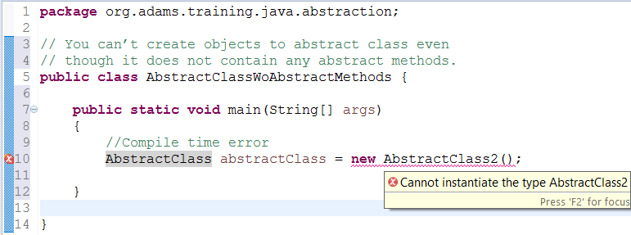
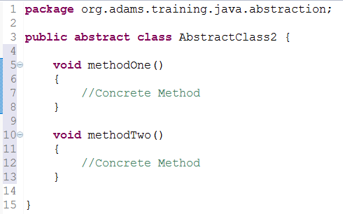
Abstract Class
You can’t create objects to abstract class even though it does not contain any abstract methods.

Slide 22
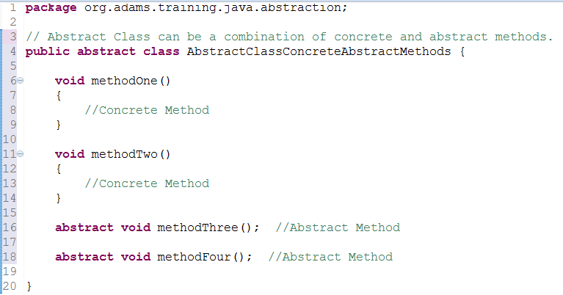
Abstract Class
Abstract Class can be a combination of concrete and abstract methods.

Slide 23
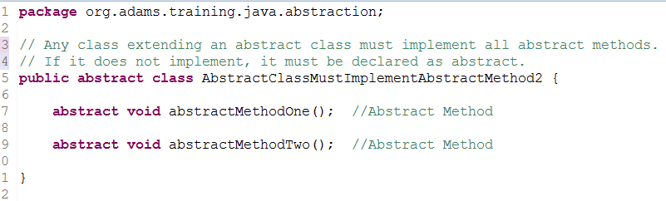
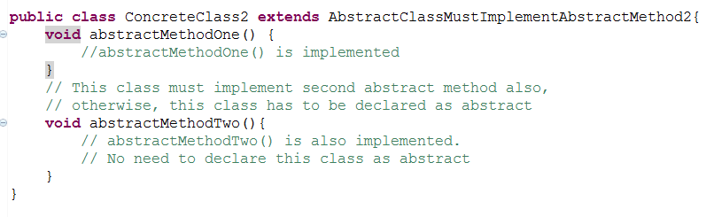
Abstract Class
Any class extending an abstract class must implement all abstract methods. If it does not implement, it must be declared as abstract.

Slide 24
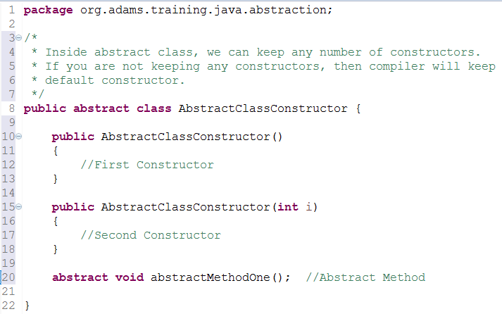
Abstract Class
Inside abstract class, we can keep any number of constructors. If you are not keeping any constructors, then compiler will keep default constructor.

Slide 25
Abstract Class
Abstract methods can not be private. Because, abstract methods must be implemented somehow in the sub classes. If you declare them as private, then you can’t use them outside the class.

Slide 26
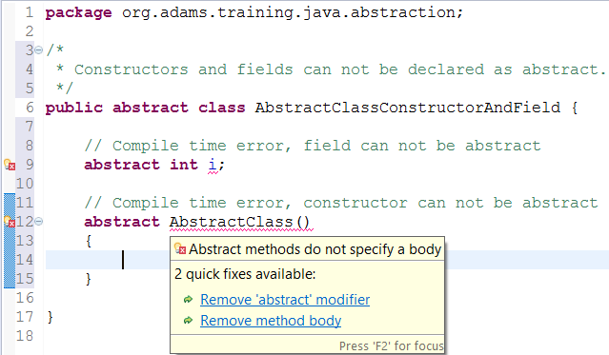
Abstract Class
Constructors and fields can not be declared as abstract.

Slide 27
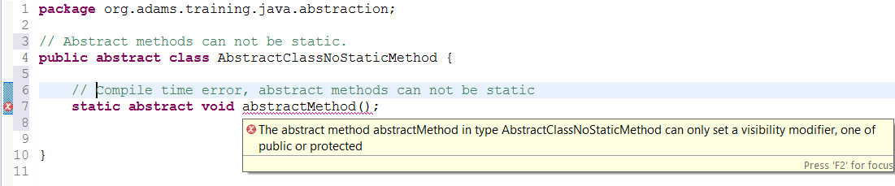
Abstract Class
Abstract methods can not be static.

Slide 28
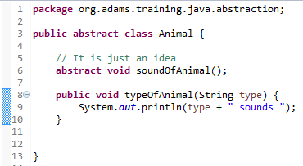
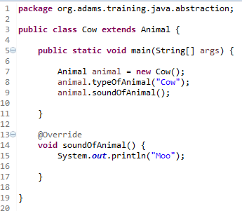
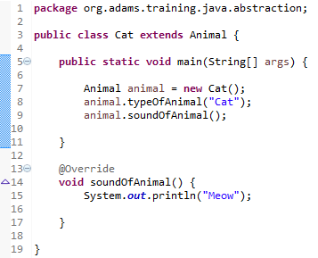

Abstract Class
Code Example

Slide 29
Interface
Interfaces in java are very much similar to abstract classes but interfaces contain only abstract methods (you can refer to them as only ideas). Abstract classes may contain both abstract methods as well as concrete methods. But interfaces must contain only abstract methods. Concrete methods are not allowed in interfaces. Therefore, Interfaces show 100% abstractness.

Slide 30
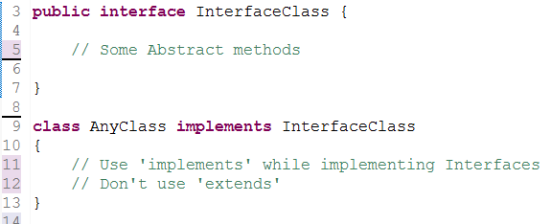
Interface
Interfaces are declared with keyword interface and interfaces are implemented by the class using implements keyword.

Slide 31
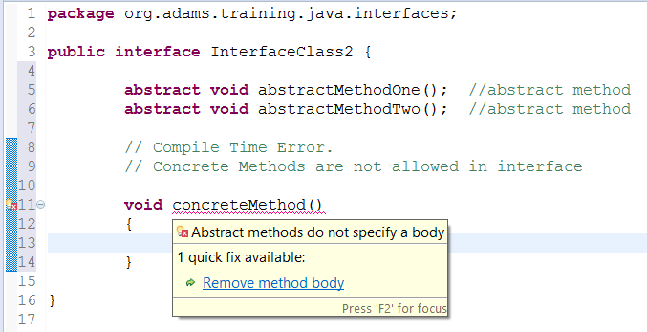
Interface
Interfaces should contain only abstract methods. Interfaces should not contain any concrete method.

Slide 32
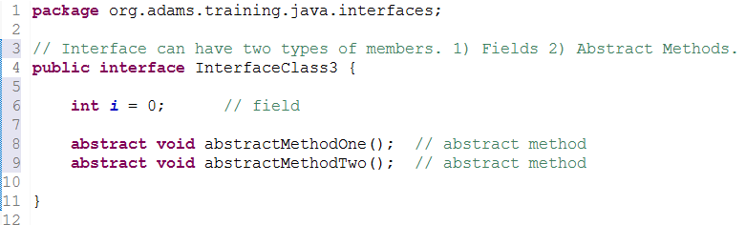
Interface
Interface can have two types of members.
1. Fields
2. Abstract Methods.

Slide 33
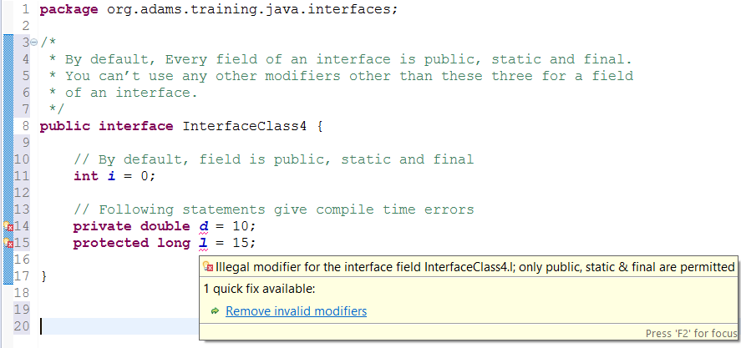
Interface
By default, Every field of an interface is public, static and final. You can’t use any other modifiers other than these three for a field of an interface.

Slide 34
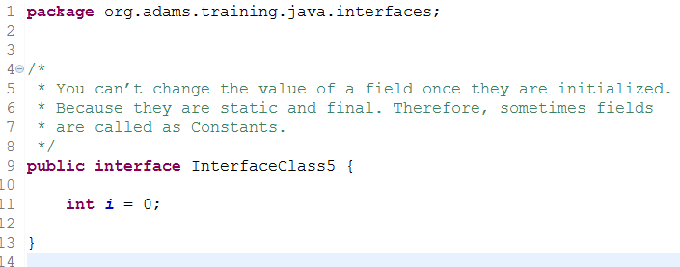
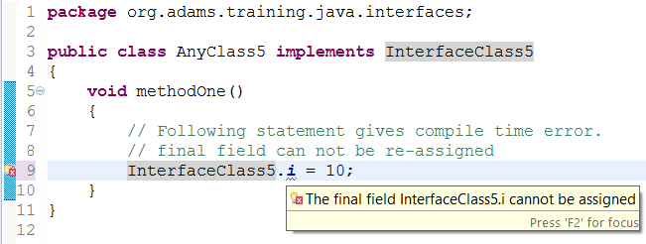
Interface
You can’t change the value of a field once they are initialized. Because they are static and final. Therefore, sometimes fields are called as Constants.

Slide 35
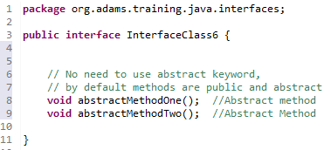
Interface
By default, all methods of an interface are public and abstract.

Slide 36
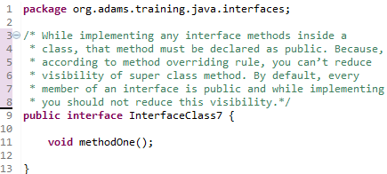
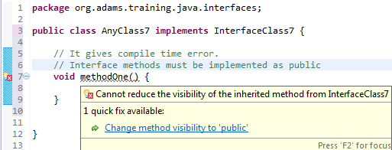
Interface
While implementing any interface methods inside a class, that method must be declared as public. Because according to method overriding rule you can’t reduce visibility of super class method. By default every member of an interface is public and while implementing you should not reduce this visibility.

Slide 37
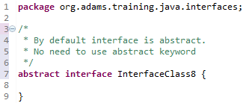
Interface
By default, Interface itself is not public but it is abstract.

Slide 38
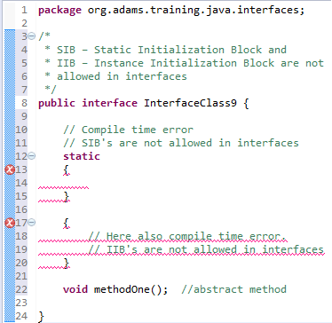
Interface
SIB – Static Initialization Block and IIB – Instance Initialization Block are not allowed in interfaces.

Slide 39
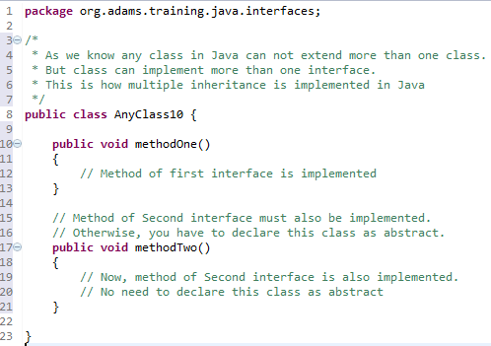
Interface
As we know any class in Java can not extend more than one class. But class can implement more than one interface. This is how multiple inheritance is implemented in Java

Slide 40
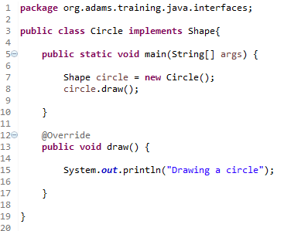

Interface
Code Example

Slide 41
Encapsulation
To achieve encapsulation in Java:
Declare the variables of a class as private
Provide public setter and getter methods to modify and view the variables values.

Slide 42
Encapsulation
Encapsulation in Java is a mechanism of wrapping the data (variables) and code acting on the data (methods) together as a single unit. In encapsulation, the variables of a class will be hidden from other classes, and can be accessed only through the methods of their current class. Therefore, it is also known as data hiding.

Slide 43
Access Modifier
Modifier | Class | Package | Subclass | World
public | Y | Y | Y | Y
protected | Y | Y | Y | N
no modifier | Y | Y | N | N
private | Y | N | N | N
Source : http://docs.oracle.com/javase/tutorial/java/javaOO/accesscontrol.html

Slide 44
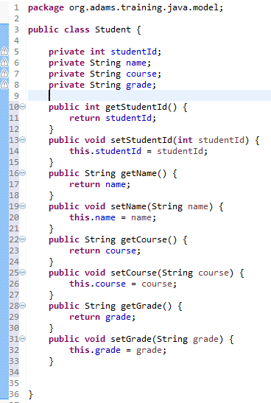
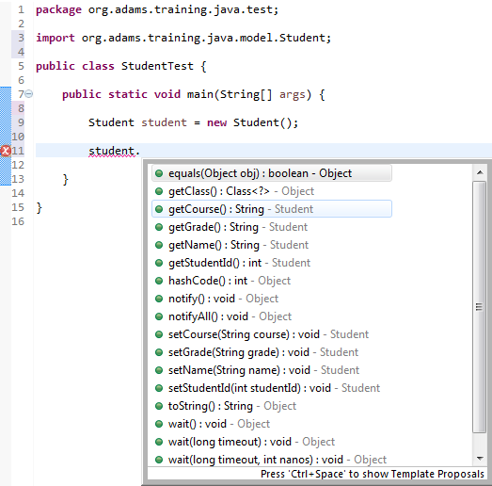
Encapsulation

Slide 45
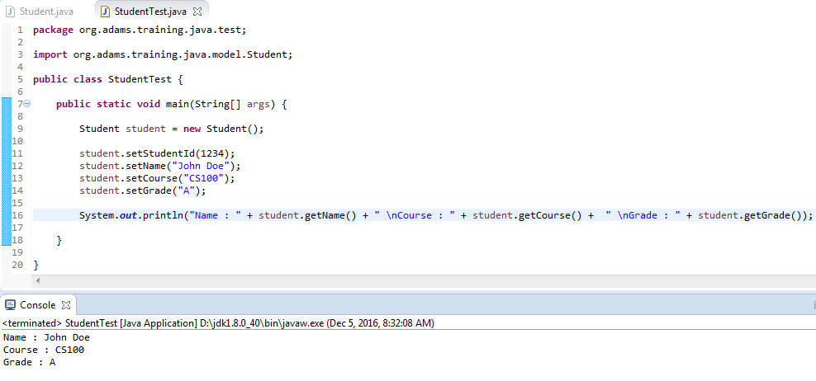
Encapsulation

Slide 46
Encapsulation

Slide 47
Abstraction vs. Encapsulation
In simple words: You do abstraction when deciding what to implement. You do encapsulation when hiding something that you have implemented.

Slide 48
Inheritence
The class which inherits the properties of other is known as subclass (derived class, child class) and the class whose properties are inherited is known as superclass (base class, parent class). extends is the keyword used to inherit the properties of a class.

Slide 49
Inheritence
The super keyword
The super keyword is similar to this keyword.
It is used to differentiate the members of superclass from the members of subclass, if they have same names. It is used to invoke the superclass constructor from subclass.

Slide 50
Inheritence
Differentiating the Members
If a class is inheriting the properties of another class. And if the members of the superclass have the names same as the subclass, to differentiate these variables we use super keyword.

Slide 51
Polymorphism
Polymorphism in Java is a concept by which we can perform a single action by different ways. Polymorphism is derived from two greek words - poly and morphs. The word poly means many and morphs means forms. So polymorphism means many forms.

Slide 52
Polymorphism
There are two types of polymorphism in java - compile time polymorphism and runtime polymorphism. We can perform polymorphism in Java by method overloading and method overriding.
If we overload static method in Java, it is the example of compile time polymorphism. We will focus on runtime polymorphism in java.

Slide 53
Exception
An exception (or exceptional event) is a problem that arises during the execution of a program. When an Exception occurs the normal flow of the program is disrupted and the program/Application terminates abnormally, which is not recommended, therefore, these exceptions are to be handled.

Slide 54
Exception
An exception can occur for many different reasons. Following are some scenarios where an exception occurs.
A user has entered an invalid data.
A file that needs to be opened cannot be found.
A network connection has been lost in the middle of communications or the JVM has run out of memory.

Slide 55
Exception
Some of these exceptions are caused by user error, others by programmer error, and others by physical resources that have failed in some manner.
Based on these, we have three categories of Exceptions.
1. Checked Exceptions
2. Unchecked Exceptions
3. Errors

Slide 56
Exception
Checked exceptions − A checked exception is an exception that occurs at the compile time, these are also called as Compile Time Exceptions. These exceptions cannot simply be ignored at the time of compilation, the programmer should take care/handle these exceptions.

Slide 57
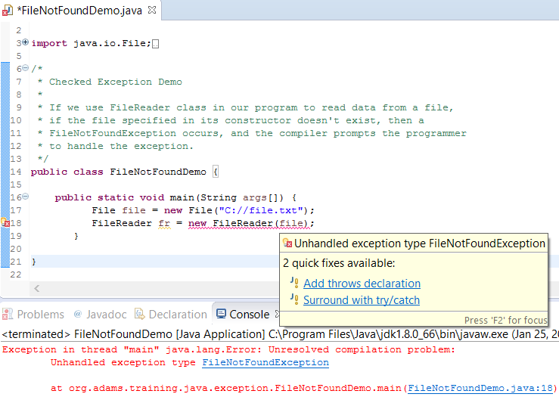
Exception

Slide 58
Exception
Unchecked exceptions − An unchecked exception is an exception that occurs at the time of execution. These are also called as Runtime Exceptions. These include programming bugs, such as logic errors or improper use of an API. Runtime exceptions are ignored at the time of compilation.

Slide 59
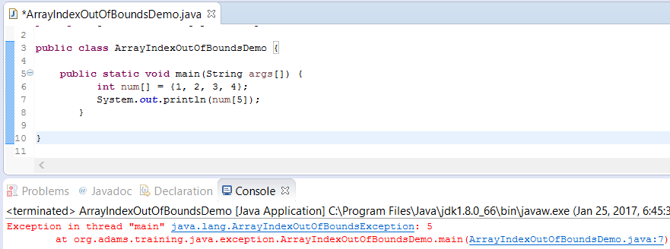
Exception

Slide 60
Exception
Errors − These are not exceptions at all, but problems that arise beyond the control of the user or the programmer. Errors are typically ignored in your code because you can rarely do anything about an error. For example, if a stack overflow occurs, an error will arise. They are also ignored at the time of compilation.

Slide 61
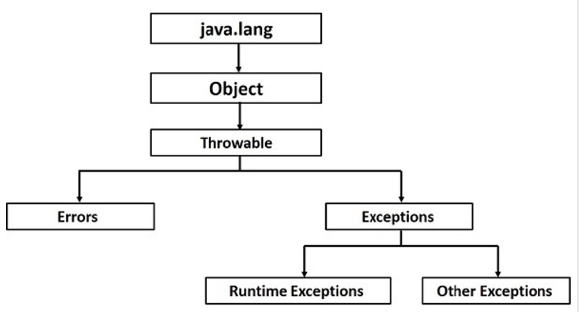
Exception Hierarchy

Slide 62
Collection
A Collection is simply an object that groups multiple elements into a single unit. Collections are used to store, retrieve, manipulate, and communicate aggregate data.
All the operations that we perform on a data such as searching, sorting, insertion, manipulation, deletion etc. can be performed by Java Collections.

Slide 63
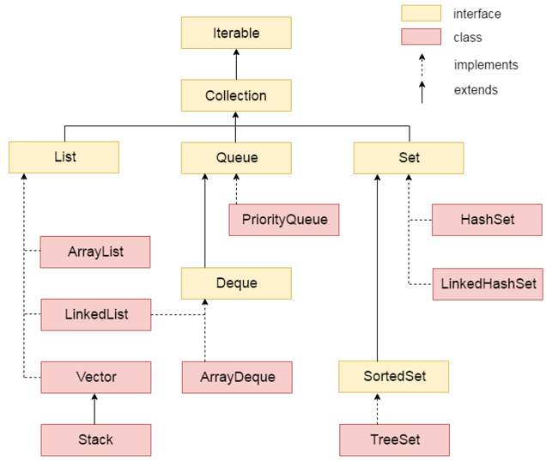
Hierarchy of Collection Framework

Slide 64
Collection vs. Collections
First of all, Collection and Collections are two different concepts. Collection is a root interface in the Collection hierarchy. Collections is an utility class in java.util package. It consists of only static methods which are used to operate on objects of type Collection. For example, it has the method to find the maximum element in a collection, it has the method to sort the collection, it has the method to search for a particular element in a collection.

Slide 65
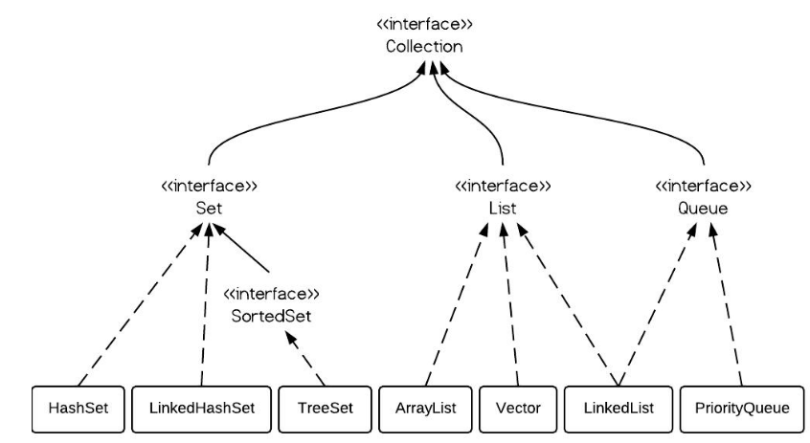
Class Hierarchy of Collection

Slide 66
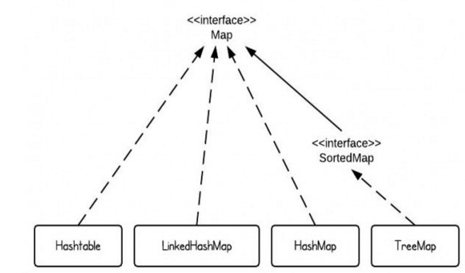
Class Hierarchy of Map

Slide 67
Summary of Classes
Interfaces | Hash Table | Resizable Array | Tree | Linked List | Hash Table & Linked List
Set | HashSet |  | TreeSet |  | LinkedHashSet
List |  | ArrayList |  | LinkedList
Queue
Map | HashMap |  | TreeMap |  | LinkedHashMap

